Slide 1
Bankruptcy Prediction
Group 5

Slide 2
Business objective
This is a classification project, since the variable to predict is binary (bankruptcy or non-bankruptcy). The goal here is to model the probability that a business goes bankrupt from different features.
The data file contains 7 features about 250 companies
The data set includes the following variables:
industrial risk: 0=low risk, 0.5=medium risk, 1=high risk.
management risk: 0=low risk, 0.5=medium risk, 1=high risk.
financial flexibility: 0=low flexibility, 0.5=medium flexibility, 1=high flexibility.
credibility: 0=low credibility, 0.5=medium credibility, 1=high credibility.
competitiveness: 0=low competitiveness, 0.5=medium competitiveness, 1=high competitiveness.
operating risk: 0=low risk, 0.5=medium risk, 1=high risk.
class: bankruptcy, non-bankruptcy (target variable).

Slide 3
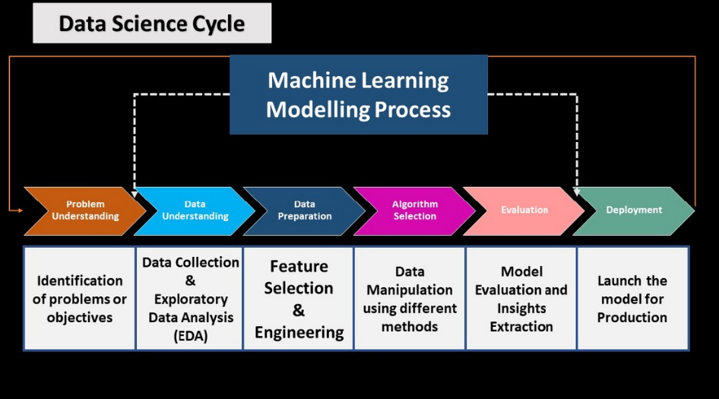
Project Workflow

Slide 4

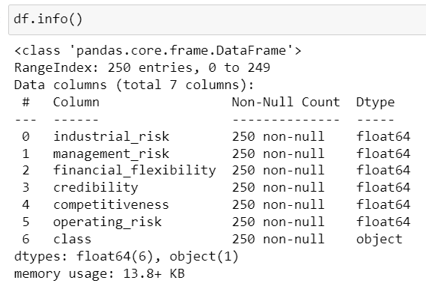
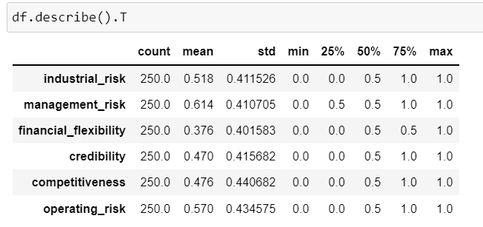
Data Set Analysis
The Data set includes the following variables:
Industrial risk
Management risk
Financial flexibility
Credibility
Competitiveness
Operating risk
Class

Slide 5
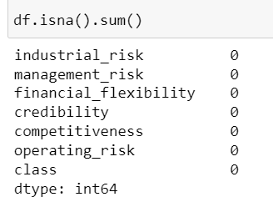
Inferences from Data Set
There are 250 records in the dataset, of which 147 are duplicates.
The data file contains seven features: six input variables and one output variable.
There are no null values in the Datafile.

Slide 6
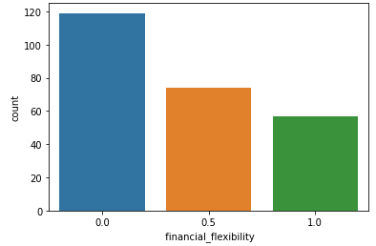
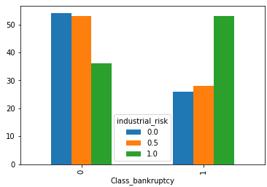
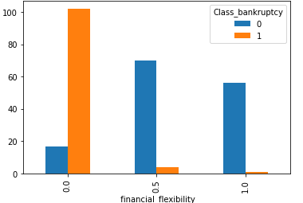
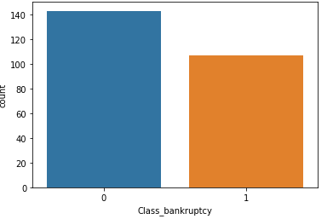
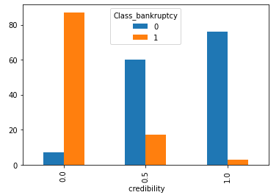
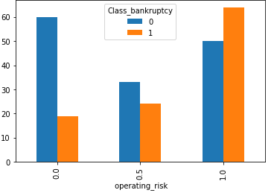
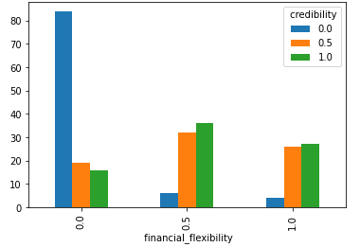

Visualization -Univariate Analysis
Target data Distribution
sub-plots for independent variables

Slide 7
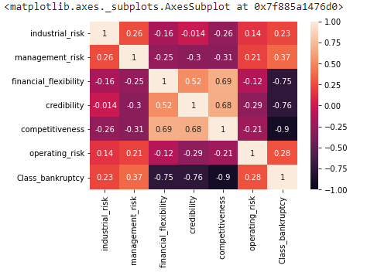
Visualization -Multivariate Analysis
Correlation
we can see financial flexibility, competitiveness and credibility are strongly correlated with the target variable(class)

Slide 8
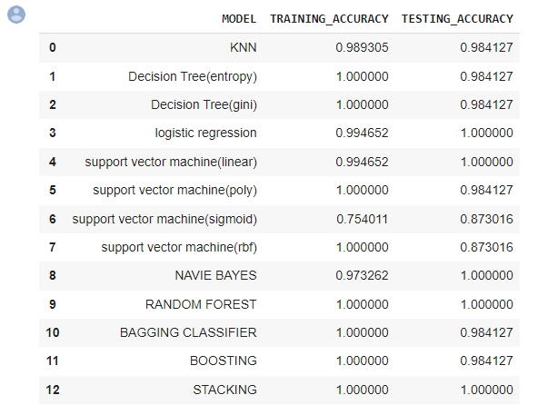
Model Building del Building

Slide 9
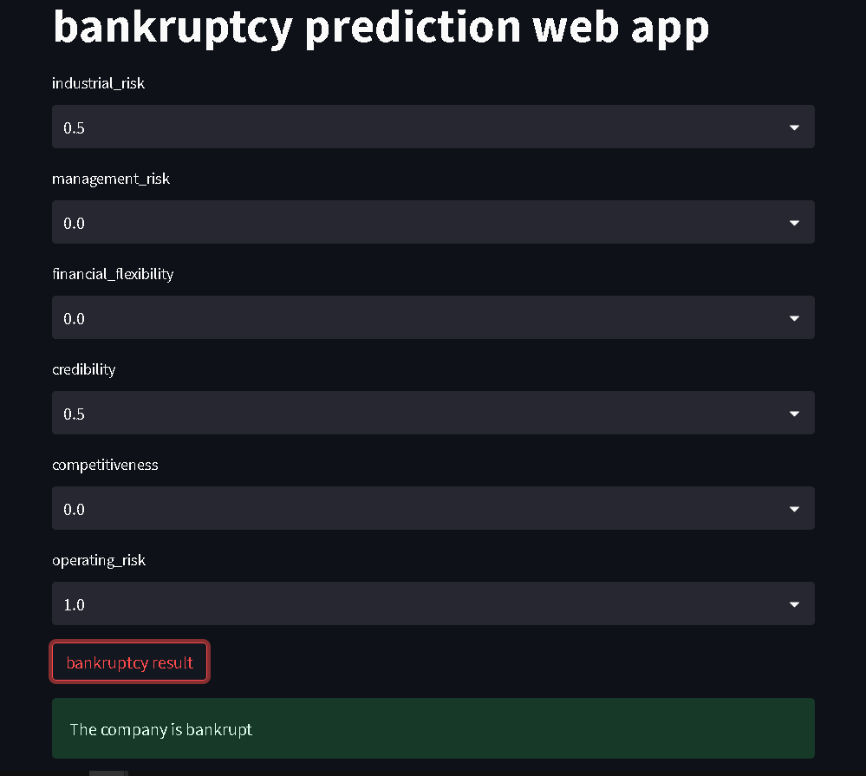
Model Deployment

